Slide 1
EY Techathon 5.0 Detailed Submission
Date of submission: 12 Jan 2025

Slide 2
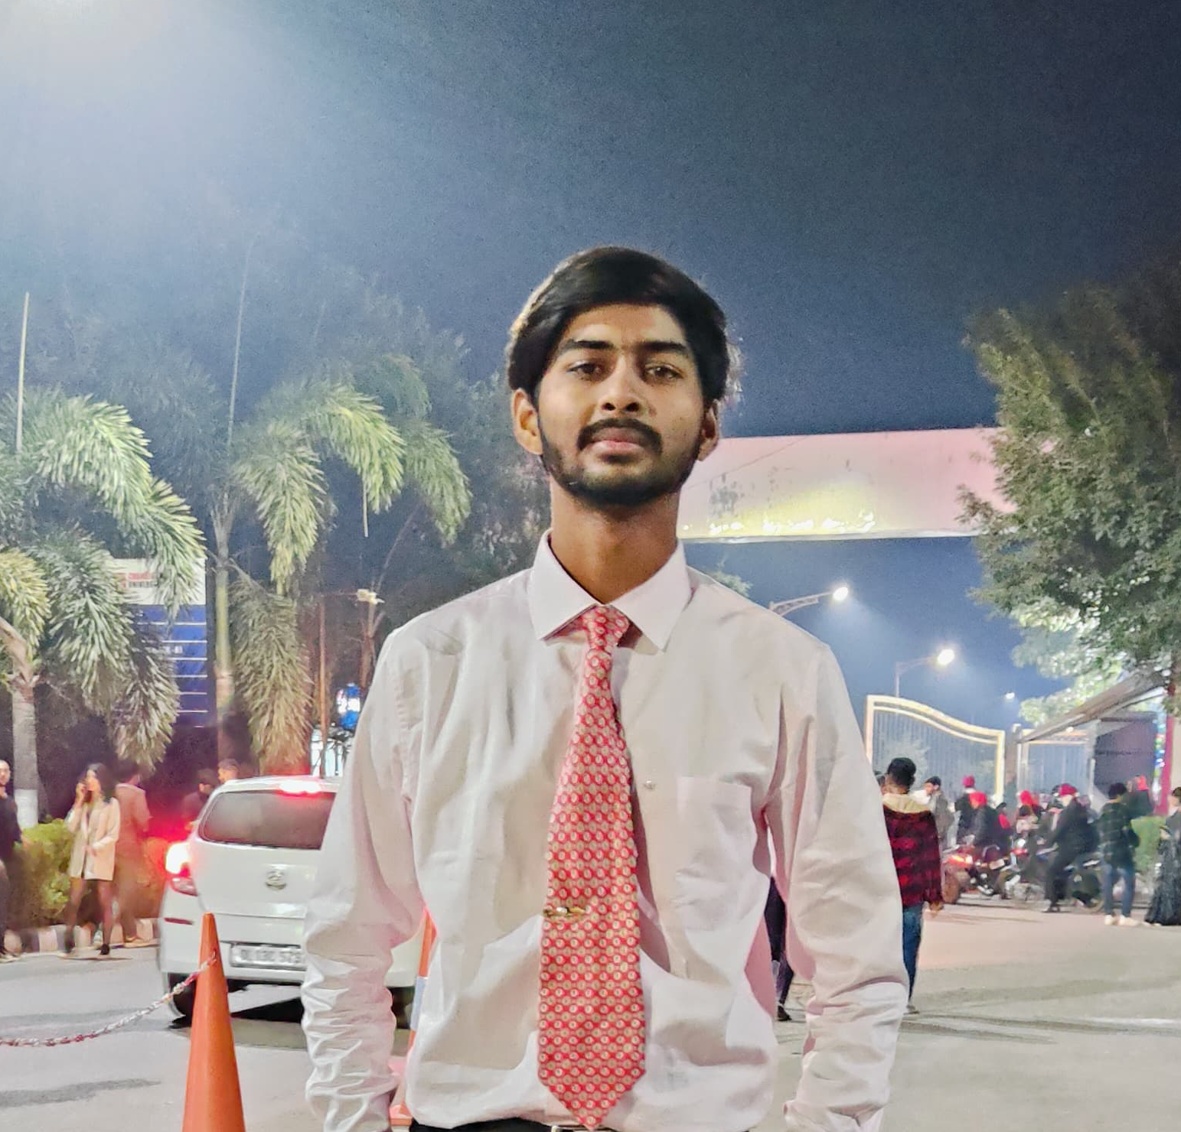
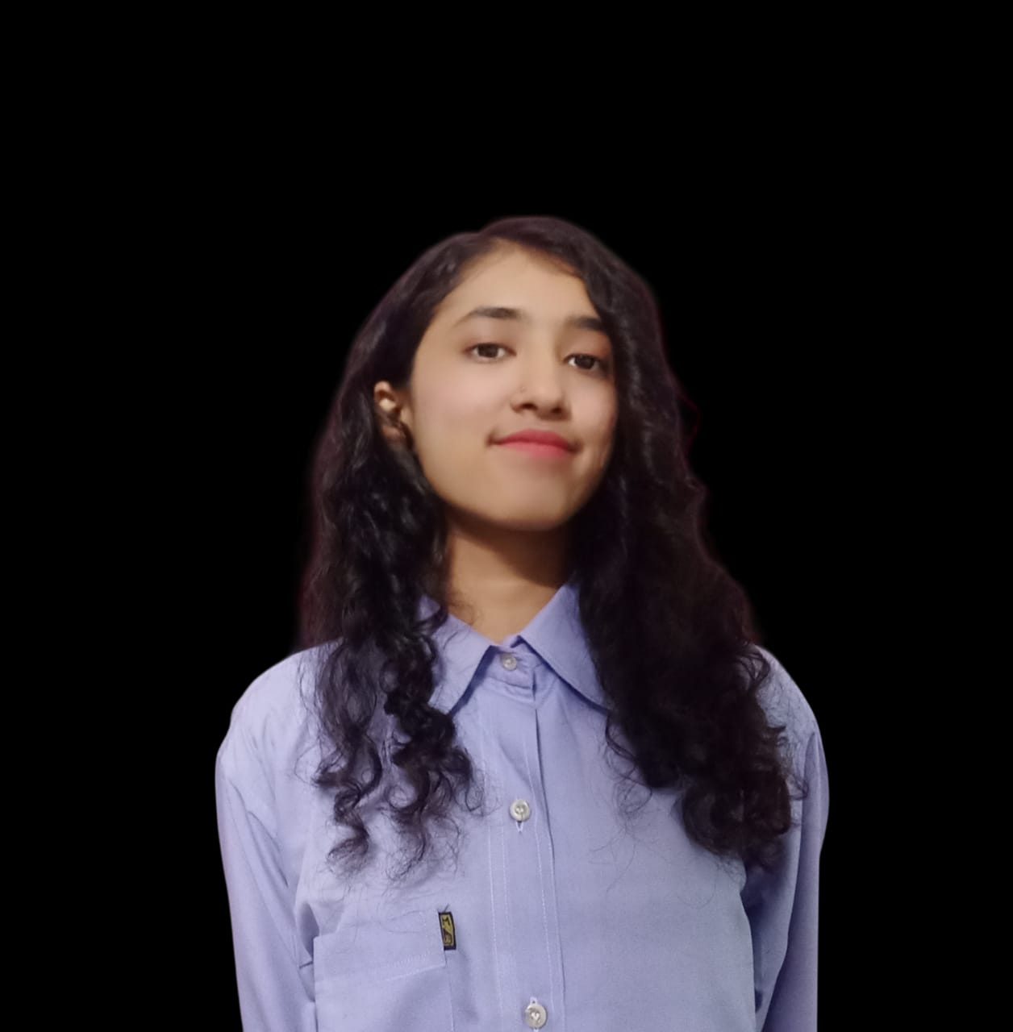
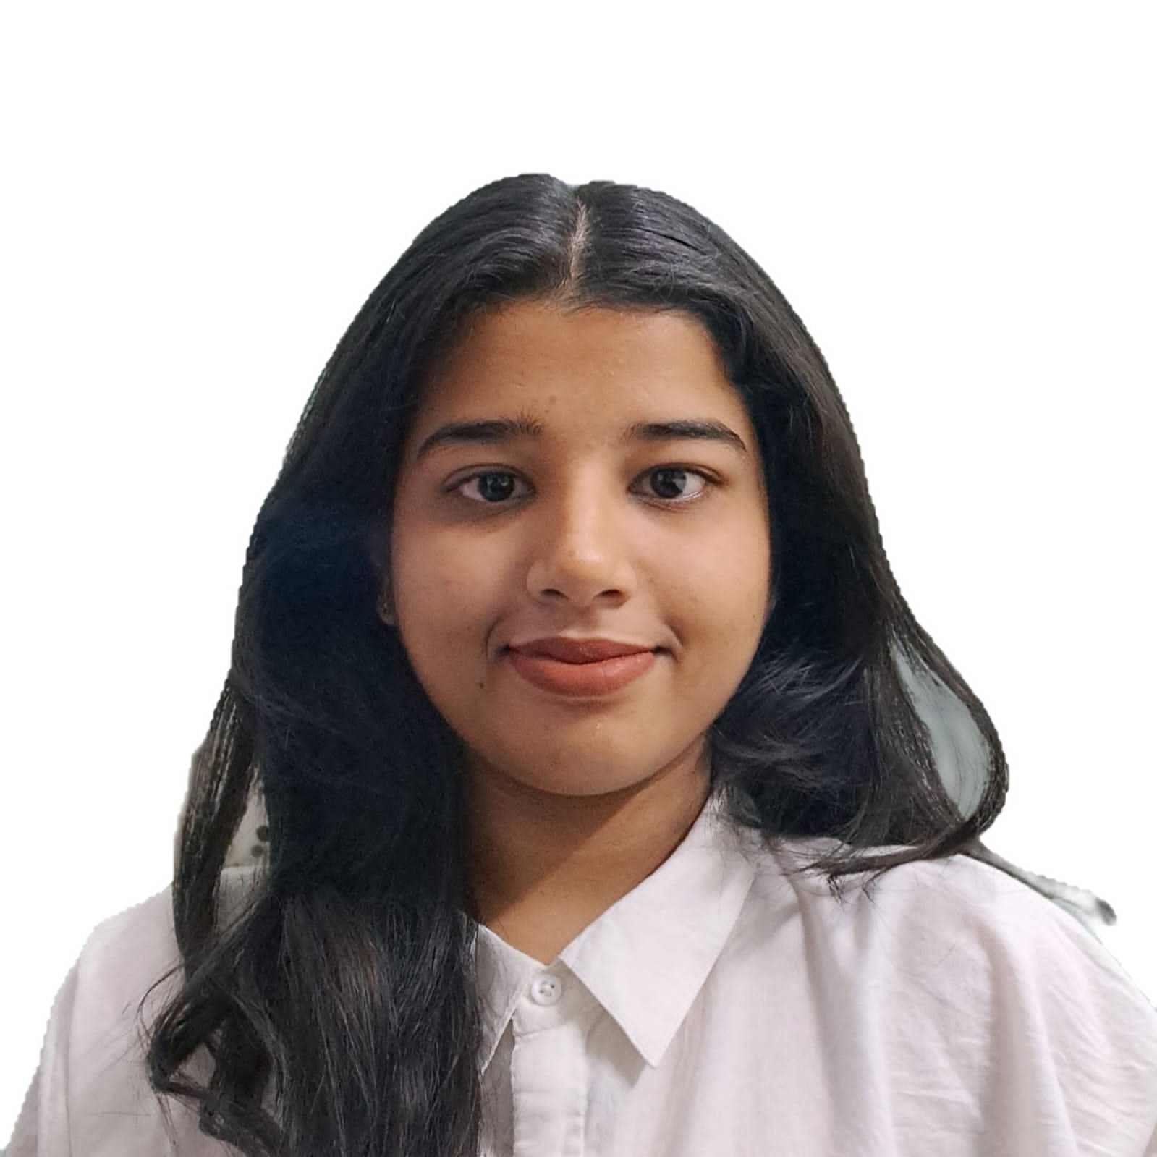
We are a dynamic group of three individuals with complementary technical expertise: Tarun Baliyan, an AI/ML enthusiast skilled in intelligent algorithms and data-driven insights; Mridula Shrivastava, a backend developer specializing in server-side programming and scalable APIs; and Aditi Shrivastava, a frontend developer focused on creating responsive, user-friendly interfaces. Together, we collaborate to deliver innovative, end-to-end solutions with creativity and precision.
Team Name: Code-e-pie
Problem Statement : Financial inclusion
Team Member 1 Name : Tarun Baliyan
College name : Chandigarh University
Contact Detail (phone number) : 8923131171
Role in Solution Development (please specify) : AI/ML Enthusiast
Team Member 2 Name : Mridula Shrivastava
College name : Banasthali Vidyapeeth
Contact Detail (phone number) : 6265 984 513
Role in Solution Development (please specify) : Backend Developer
Team Member 3 Name : Aditi Shrivastava
College name : Global Institute of Technology
Contact Detail (phone number) : 6261174228
Role in Solution Development (please specify) : Front end Developer

Slide 3
Executive Summary (minimum 200 words)
ARTHSHAKTI: Revolutionizing Women Empowerment through Technology
ARTHSHAKTI is more than just a platform, for it stands out as the beginning of an all-new revolutionary approach to the concept of women empowerment in rural India. Using sophisticated technology, challenges turn into opportunities; millions of women are thus enabled to pursue their path towards economic independence, leadership, and self-confidence. Dismantle barriers limiting potential and spark a future in which ambition thives without any barriers.
At its core, ARTHSHAKTI is an integration of cutting-edge technologies into a scalable and accessible ecosystem that includes:
AI-Powered Personalization: Tailored financial literacy modules and mentorship recommendations use machine learning to adapt to individual user needs, ensuring relevance and engagement.
Blockchain-Based Financial Tools: A decentralized, secure system for microloans and investment tracking, fostering trust and transparency in financial transactions.
Full-Stack Excellence-Strong architecture based on React.js front end for sleek, intuitive use and Node.js/Python for high-performance back-end support by MongoDB for seamless data management.
Smart API integration: There will be real-time data synchronization with the ARTHSHAKTI mobile app for a well-integrated user experience from notifications to progress tracking.
Cloud-native scalability built on AWS or Azure gives unmatched reliability along with auto-scaling capabilities and brings the feature of global reach for ensuring that the platform adapts as per user demand.
Advanced Security: End-to-end encryption, role-based access control, and biometric authentication ensure a fortified, user-first experience.
ARTHSHAKTI’s dynamic content management system empowers administrators to continuously enhance the platform, while community-driven features amplify user engagement. The platform also complies with WCAG standards, making it inclusive for women across diverse abilities and regions.
More than technology, ARTHSHAKTI is about impact. Imagine a rural woman finding financial literacy and microloans for herself and others, creating a ripple effect of empowerment throughout an entire village. This is the ARTHSHAKTI promise: to create leaders who transform societies.
EY's Hackathon is the opportunity to align innovation with purpose. ARTHSHAKTI epitomizes that synergy, as revolutionary technology converges with a mission to bring about systemic change. EY can spearhead a future where no woman's potential goes unrealized. Together, we can spark a revolution. Let's make history.

Slide 4
Women in rural India face critical barriers to achieving financial independence and economic participation. These barriers include limited access to education, mentorship, and financial tools, compounded by a lack of tailored, technology-driven solutions. As a result, they remain excluded from opportunities for personal growth and community leadership. ARTHSHAKTI aims to address these challenges through a scalable platform that empowers women with knowledge, tools, and a supportive ecosystem to achieve their full potential.
Target Industry:
Fintech and Education Technology (EdTech)
Industry Type: B2B2C (Business-to-Business-to-Consumer)
Businesses (B2B): NGOs, microfinance institutions, government schemes, and corporate CSR programs supporting the initiative.
Consumers (B2C): Rural women directly engaging with the platform for financial education and mentorship.
User Group: Rural Women – Primarily those from underserved communities seeking financial literacy, mentorship, and growth opportunities.
User Department: Community Development and Financial Empowerment – This includes non-profit organizations, microfinance institutions, and CSR wings focused on women’s economic development.
Solution Scenario:
User Registration: Rural women sign up on the ARTHSHAKTI platform via the mobile app or website using basic details like their phone number and demographic information.
Personalized Dashboard: AI curates a personalized dashboard with financial literacy modules, investment tools, and mentorship opportunities.
Learning Pathway: Users engage with educational content, complete assessments, and receive certifications in financial literacy.
Mentorship Matching: Users are paired with mentors based on their goals and needs.
Microloans and Investment Tools: Users access microloan options, track investments, and monitor financial growth through blockchain-based tools.
Community Interaction: A community feature allows users to share experiences, post questions, and support each other.
Progress Tracking and Notifications: Real-time notifications keep users updated on their progress, upcoming mentorship sessions, or financial updates.
Proposed Data Flow:
Data Capture:
User Input: Basic details (name, contact, demographics) and ongoing engagement data (progress in modules, mentorship feedback).
Financial Data: Microloan application details, repayment status, and investment history.
Data Processing:
AI/ML algorithms analyze user input to personalize content and recommend mentorship matches or financial tools.
Data Storage:
A secure cloud database (e.g., AWS or Azure) stores all user data, encrypted for safety.
Data Exchange:
API integration ensures real-time data synchronization between the ARTHSHAKTI app and website.
Notifications, user dashboards, and progress tracking are dynamically updated.
Data Output:
Aggregated insights are shared with NGOs, government agencies, and financial partners (in anonymized formats) to measure impact and optimize support strategies.

Slide 5
To address the challenges faced by women in accessing job opportunities and learning resources, the ARTHSHAKTI app will serve as a dedicated platform that connects women with various opportunities across multiple sectors. Our approach involves creating a user-friendly interface that enables women to network, learn, and find job opportunities tailored to their skills and interests. The app will include features such as personalized user profiles, opportunity listings, community engagement tools, and feedback mechanisms to ensure continuous improvement and user satisfaction.
Please elaborate on the solution value proposition to the target user group. How will your solution cover the problem areas?
Response: ARTHSHAKTI empowers women by providing a centralized platform for accessing tailored job opportunities and resources, enhancing their skills and professional connections.
What are the impact metrics that you propose to use to analyse the effect of the solution?
Response: We will measure success through user engagement metrics (DAU, MAU), opportunity utilization rates, user satisfaction scores, community interaction levels, and the success rate of job placements.
What are the technologies (languages, platforms, APIs, hardware, sponsored tools, technologies stacks, framework etc.) involved?
Response: The app will utilize React Native for mobile development, Node.js for the backend, PostgreSQL for the database, and cloud services like AWS for hosting and storage.
Please state the assumptions, constraints and solution decision points (Reason behind choosing a technology)
Response: We assume users have smartphone access and basic app familiarity while facing constraints like budget and time. We chose React Native for cross-platform compatibility and PostgreSQL for its robustness.
How easily can your solution be implemented and how effective will it be?
Response:The solution can be implemented in phases, starting with core features, allowing for quick deployment and iterative improvements based on user feedback.
How robust / secure / easily scalable and extensible is the solution?
Response: The app will incorporate security best practices, ensuring data protection while being designed for scalability and extensibility to accommodate future growth and feature additions.
What are the solution components that you would like to build and demonstrate; if you progress through next round.
Response: We aim to demonstrate user profile management, dynamic opportunities listings, community engagement features, and a feedback mechanism in the next round.

Slide 6
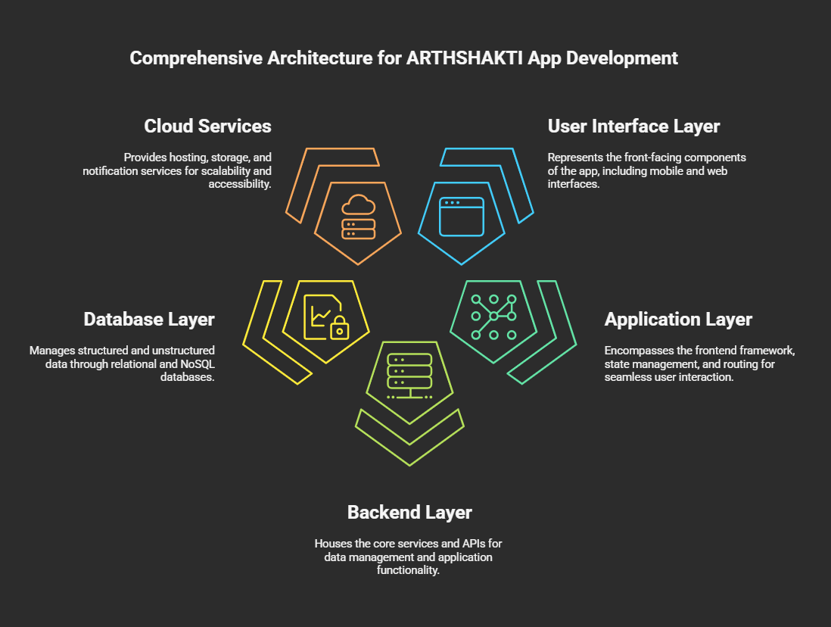
Attach and submit the below as separate files
Architecture diagram (mandatory)

Slide 7
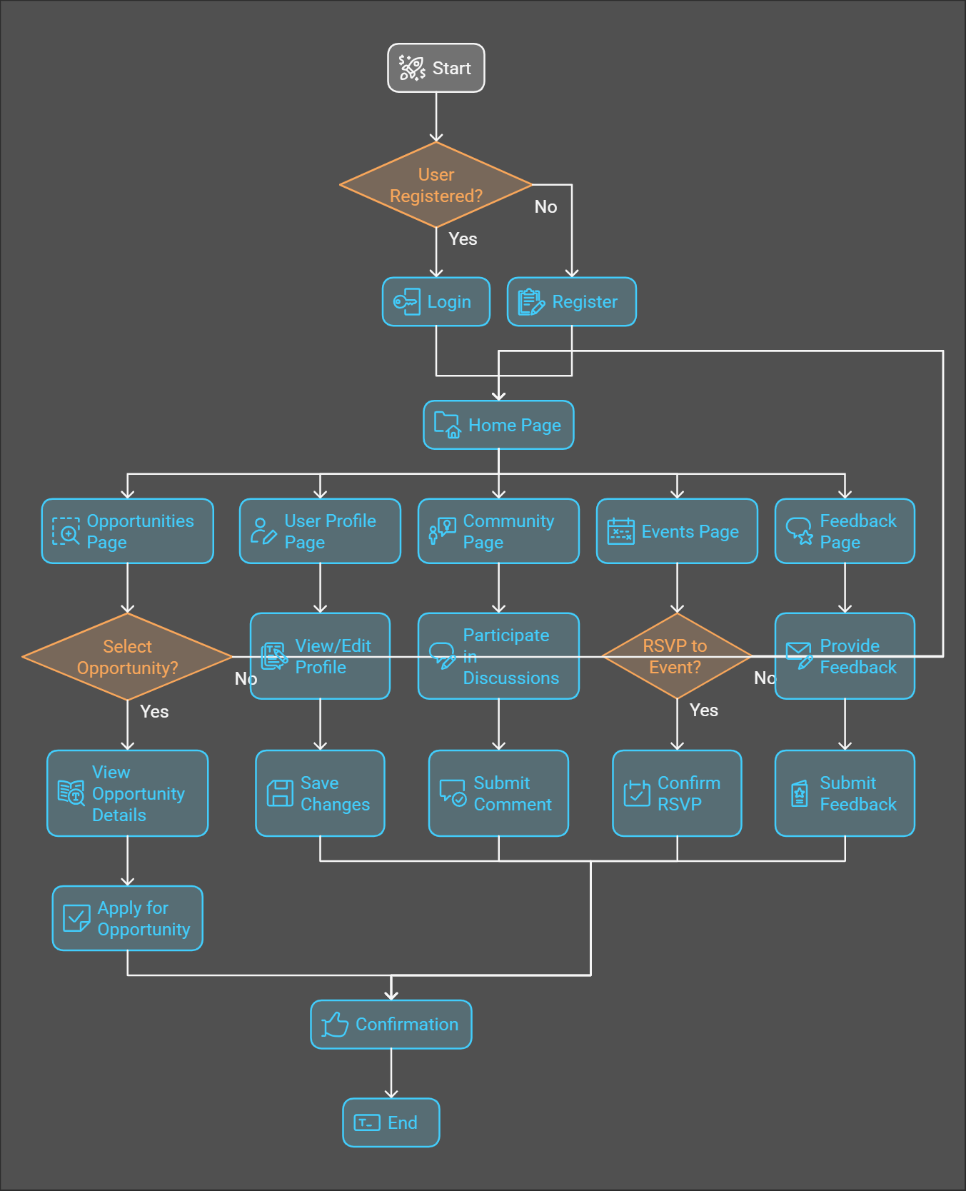
Attach and submit the below as separate files
Flow chart (mandatory)

Slide 8
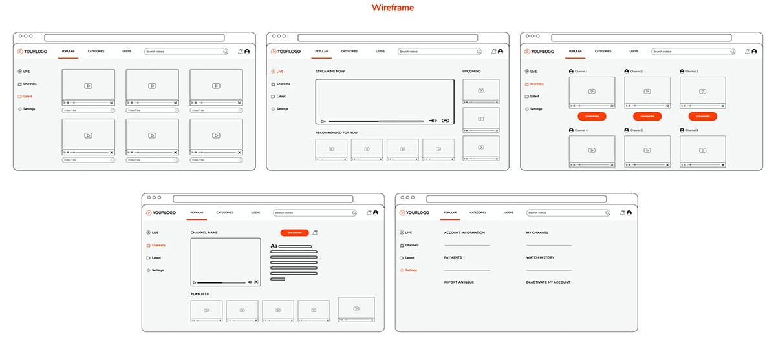
Attach and submit the below as separate files
Wireframes (mandatory)

Slide 9
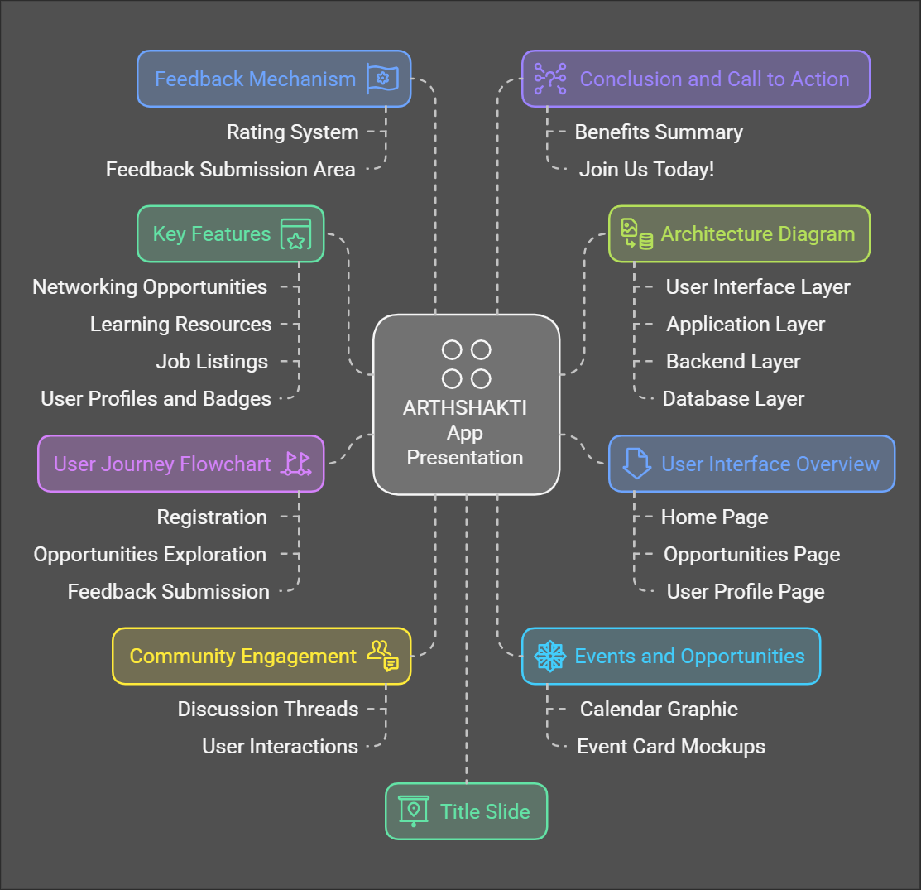
Attach and submit the below as separate files
Graphical representation (bar graph, histogram, pie charts, heat maps) (optional)

Slide 10
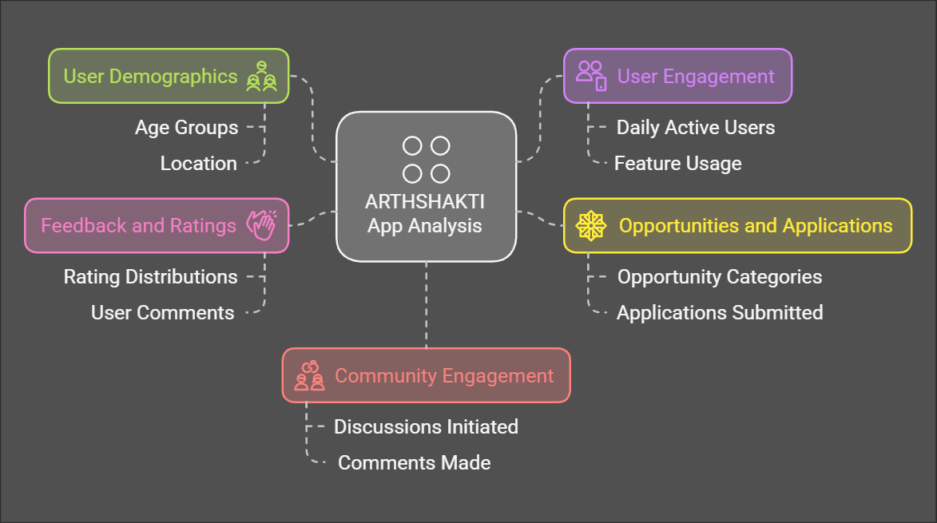
Attach and submit the below as separate files
Analysis, visualization (optional)

Slide 11
Attach and submit the below as separate files
Code Repository (optional)
https://github.com/Beatevil/Arthshakti.git

Slide 12
[Attach Video, link for demo] or [output/visualizations from the prototype]
https://drive.google.com/drive/folders/1p51kMuBLpc1ggTiK6BkzupBTWq0MpNjc?usp=sharing

Slide 13
Thank you
Date of submission: 12 Jan 2025

